Slide 1
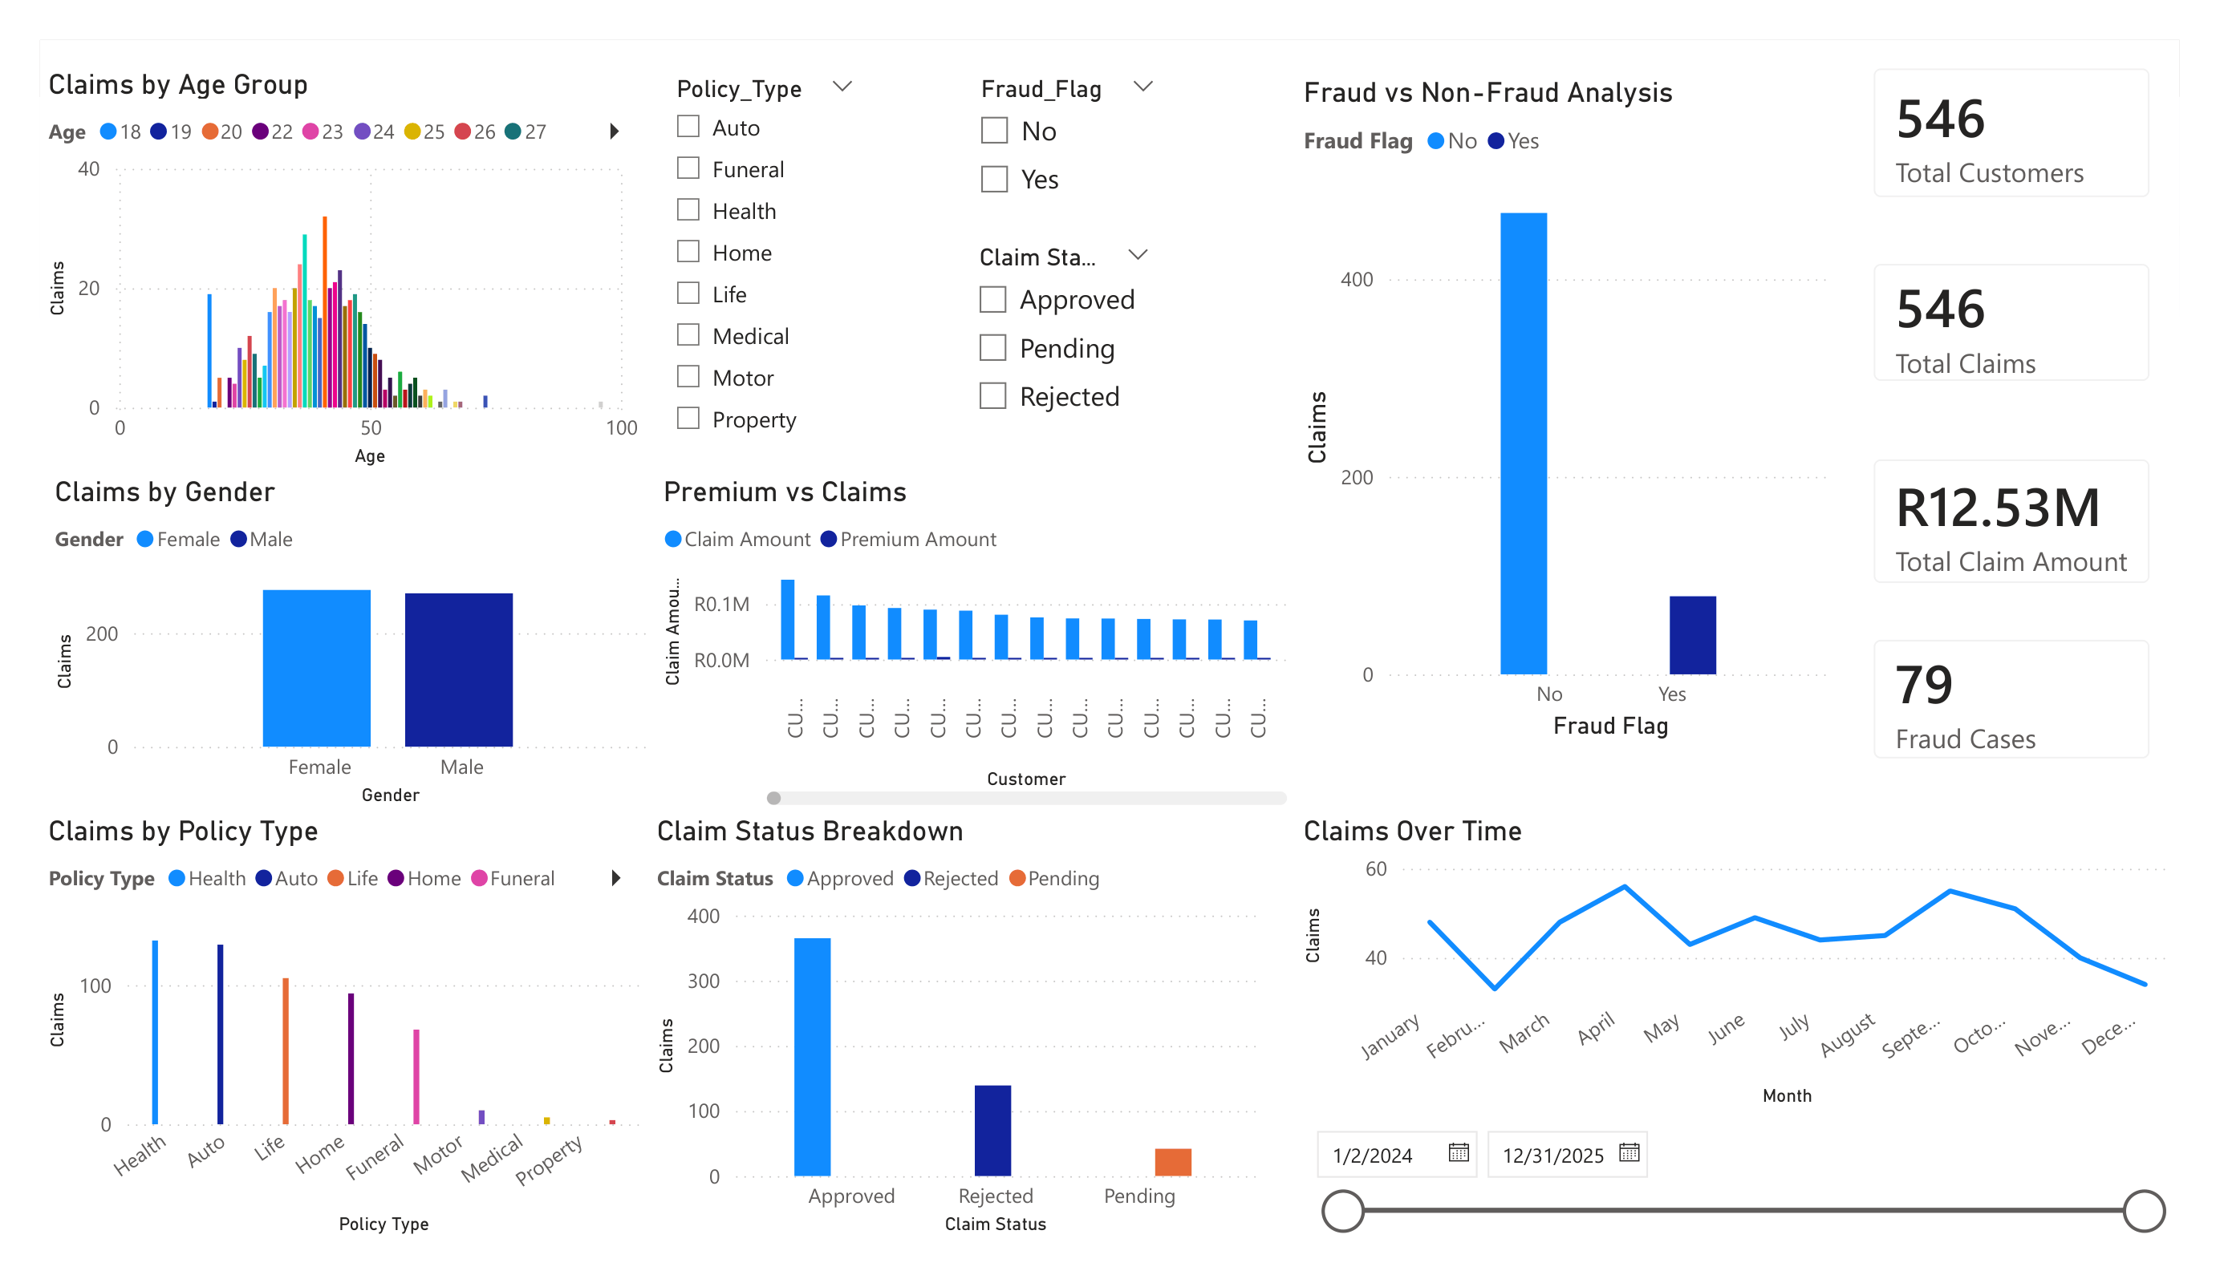
Customer Risk & Claims Analysis for an Insurance Company
A report on the Fraud Analysis of Claims
from customers of an Insurance Company

Slide 2
Project Overview & Background
This project analyzes the claims of an insurance company that is facing:
Increasing claim costs
Suspected fraudulent claims
Low customer retention
The tools used:
SQL (Databricks)
Power BI (Dashboard)
Power Point (Presentation)

Slide 3
Dataset Structure
Customer_ID
Age
Gender
Province
Monthly_Income
Join_Date
Policy_ID
Policy_Type
Premium Amount
Policy_Status
Claim_ID
Claim_Date
Claim_Amount
Claim_Status
Fraud_Flag
Unique customer
Customer age
Male/Female
Province/City
Customer income
Date that customer joined policy
Policy identifier
Auto / Health / Life
Monthly premium
Active / Cancelled
Claim identifier
Date of claim
Amount claimed
Approved / Rejected
Yes / No

Slide 4
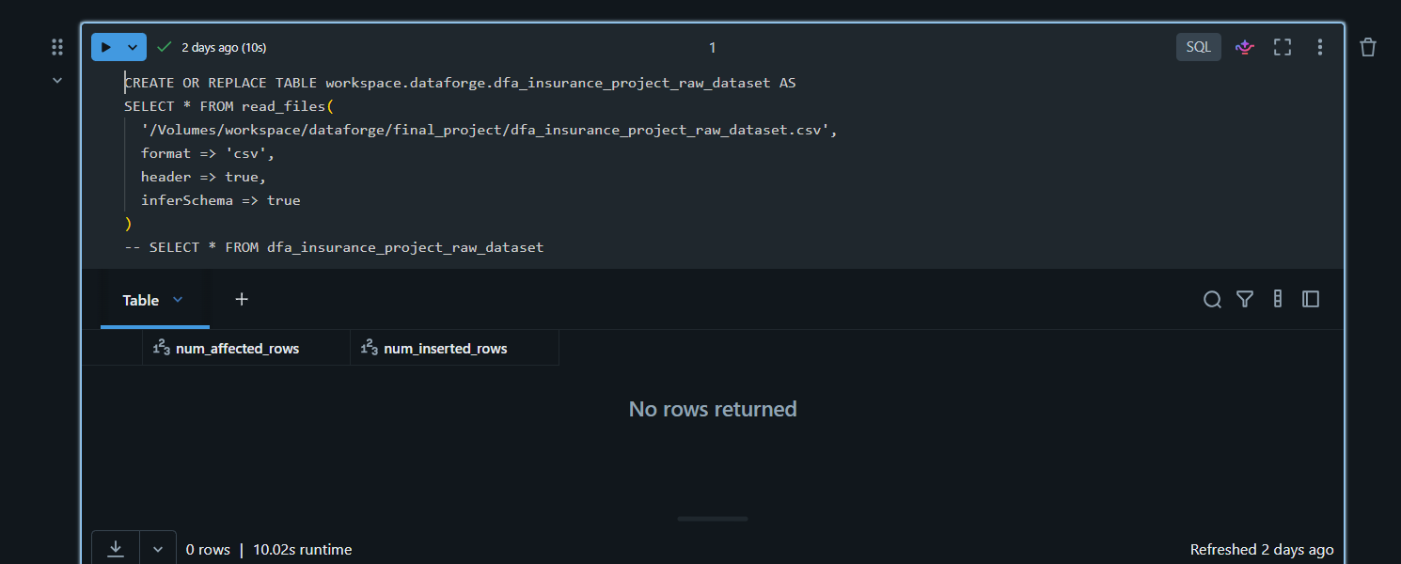
Data Exploration
The insurance dataset was uploaded onto Databricks and was processed using SQL in a notebook
The dataset was used to create a table in a database using SQL

Slide 5
Data Exploration Questions
The Following questions were answered in the data exploration notebook:
Total number of customers
Total number of policies
Total number of claims
Total claim amount
Claims by policy type
Average claim amount per policy type
Number of fraud vs non-fraud claims
Top 5 highest claim amounts
Claims per location
Claims trend over time

Slide 6
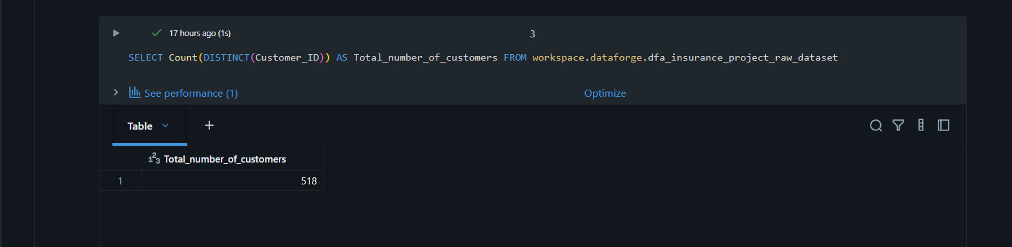
Total number of customers
Total number of customers is 518 customers

Slide 7
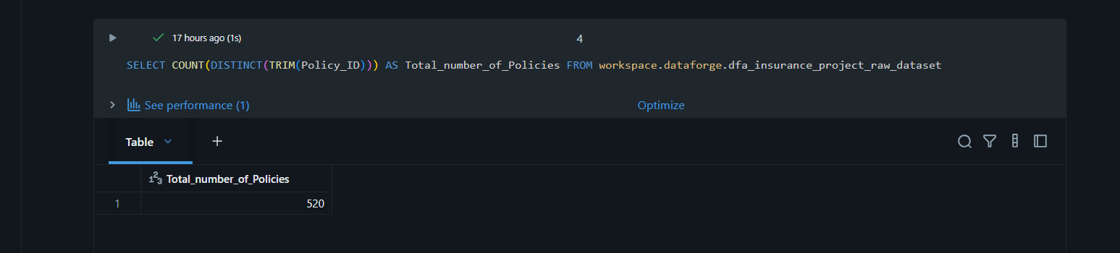
Total number of policies
Total number of policies is 520 policies

Slide 8
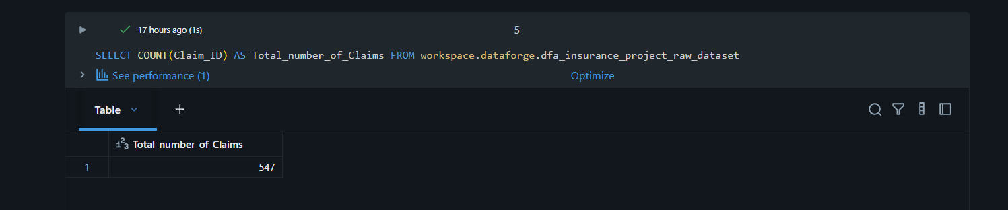
Total number of claims
Total number of claims is 547 claims

Slide 9
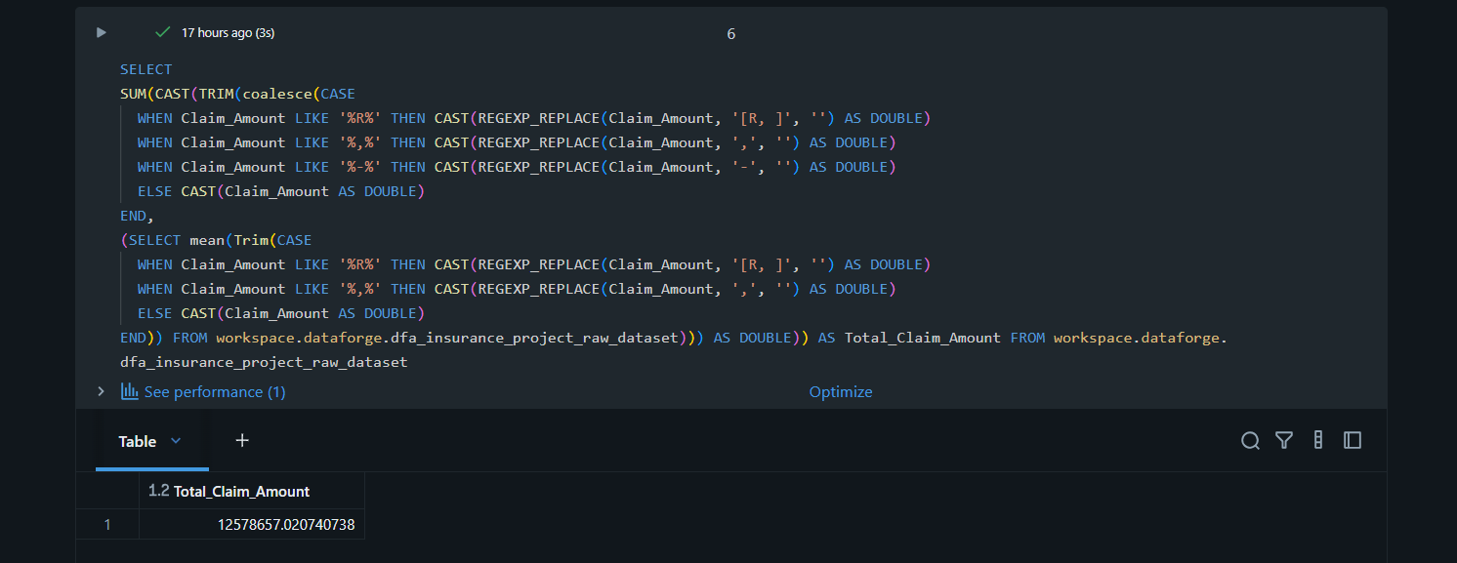
Total claim amount
Total Claim Amount is R12 578 657.02

Slide 10
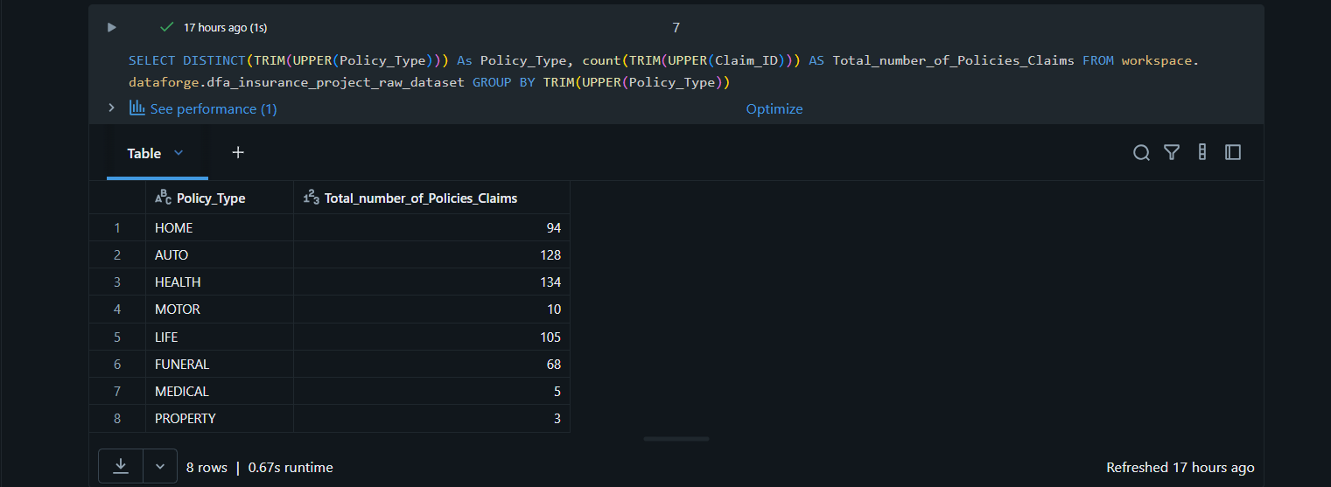
Claims by policy type
Home policy has 94 claims
Auto policy has 128 claims
Health policy has 134 claims
Motor policy has 10 claims
Life policy has 105 claims
Funeral policy has 68 claims
Medical policy has 5 claims
Property policy has 3 claims

Slide 11
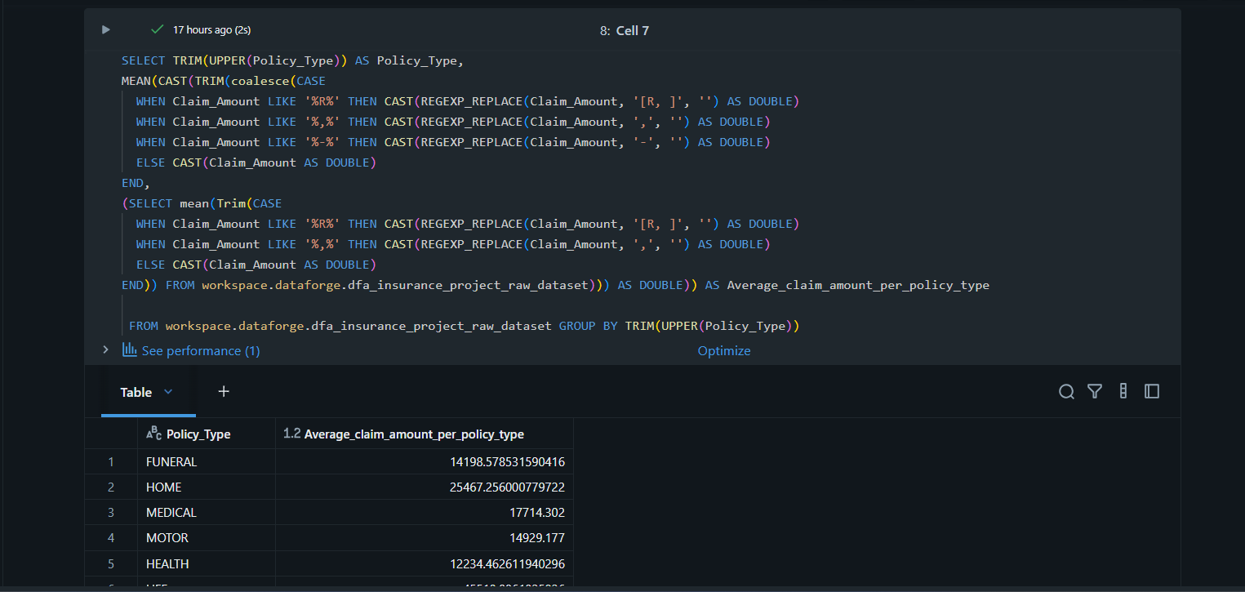
Average claim amount per policy type
Funeral policies claimed R14198.58
Home policies claimed R25467.26
Medical policies claimed R17714.30
Motor policies claimed R14929.18
Health policies claimed R12234.46
Life policies claimed R45518.10
Auto policies claimed R19049.83
Property policies claimed R20201.64

Slide 12
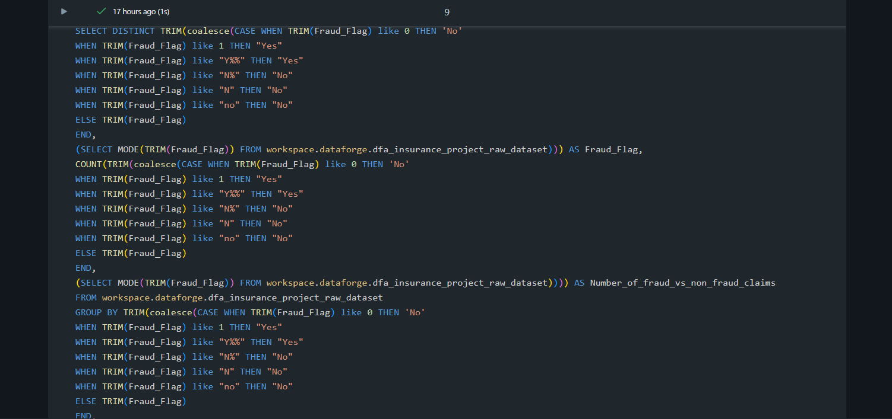
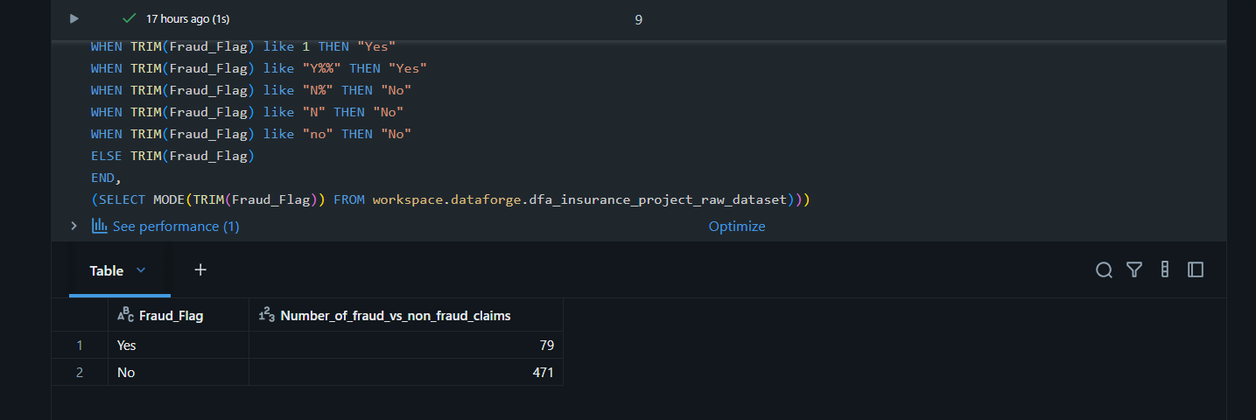
Number of fraud vs non-fraud claims
79 fraudulent claims
471 non-fraudulent claims

Slide 13
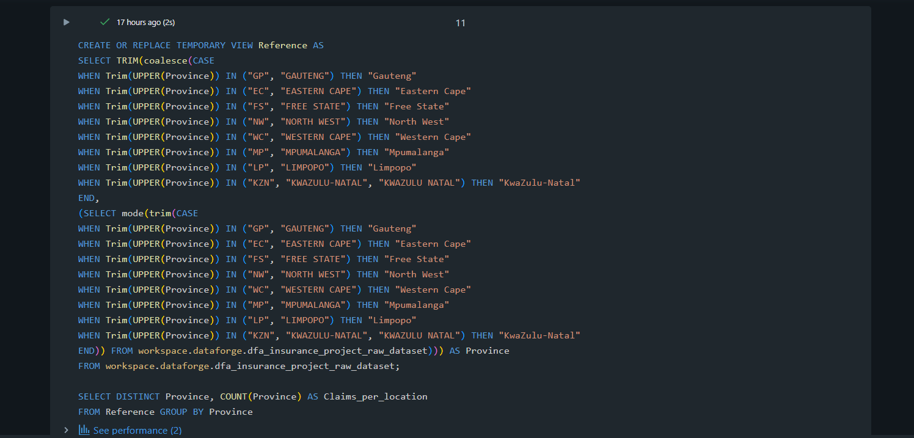
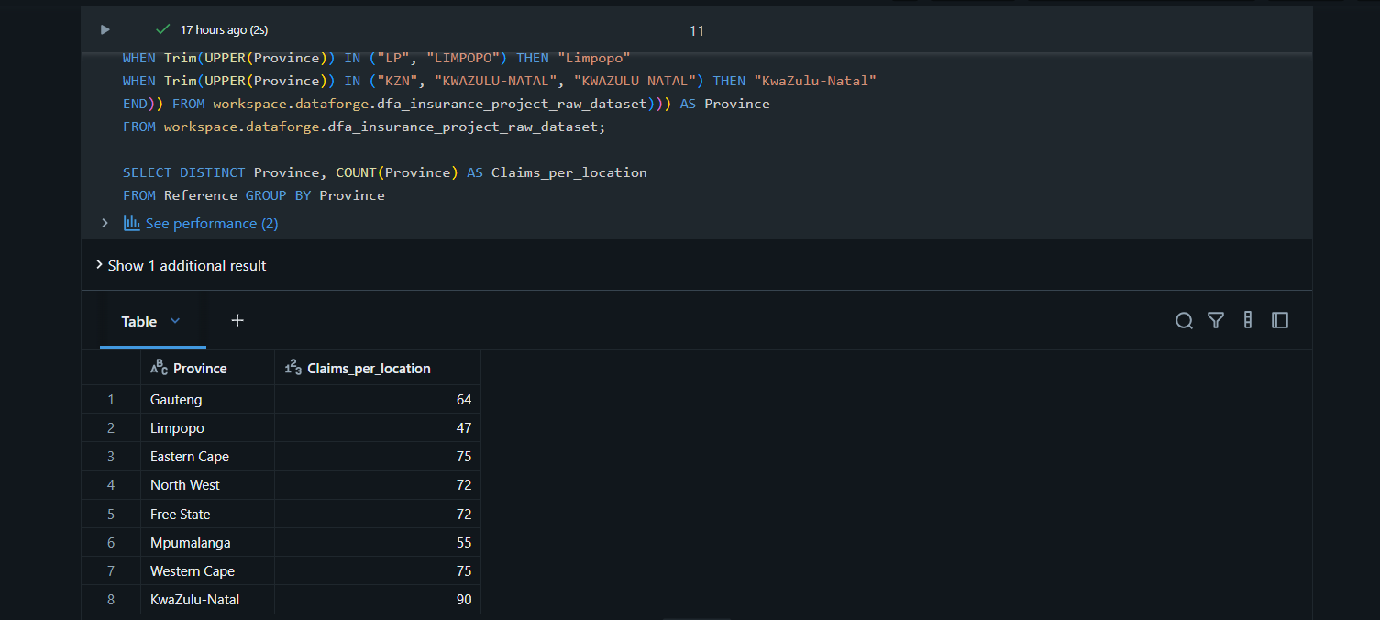
Claims per location
Gauteng has 64 claims
Limpopo has 47 claims
Eastern Cape 75 claims
North West has 72 claims
Free State has 72 claims
Mpumalanga has 55 claims
Western Cape has 75 claims
KwaZulu-Natal has 90 claims

Slide 14
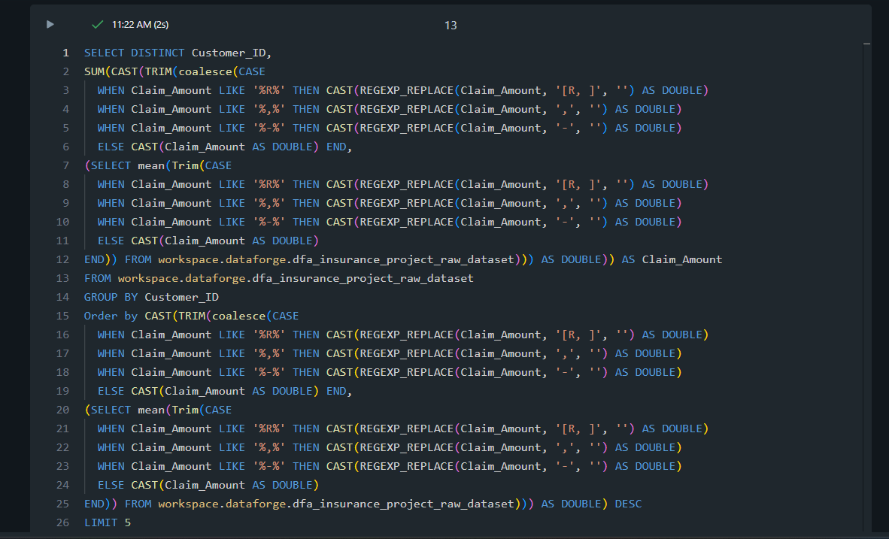
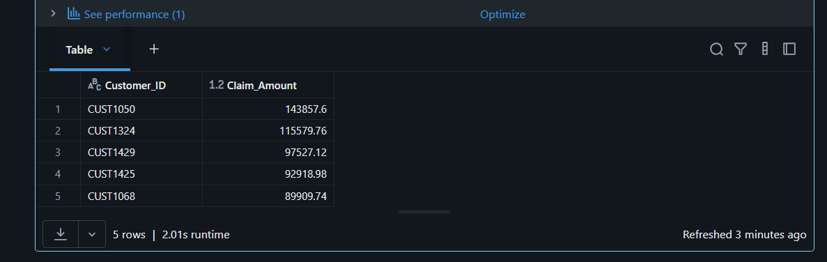
Top 5 highest claim amounts
CUST1050 claimed R143857.60
CUST1324 claimed R115579.76
CUST1429 claimed R97527.12
CUST1425 claimed R92918.98
CUST1068 claimed R89909.74

Slide 15
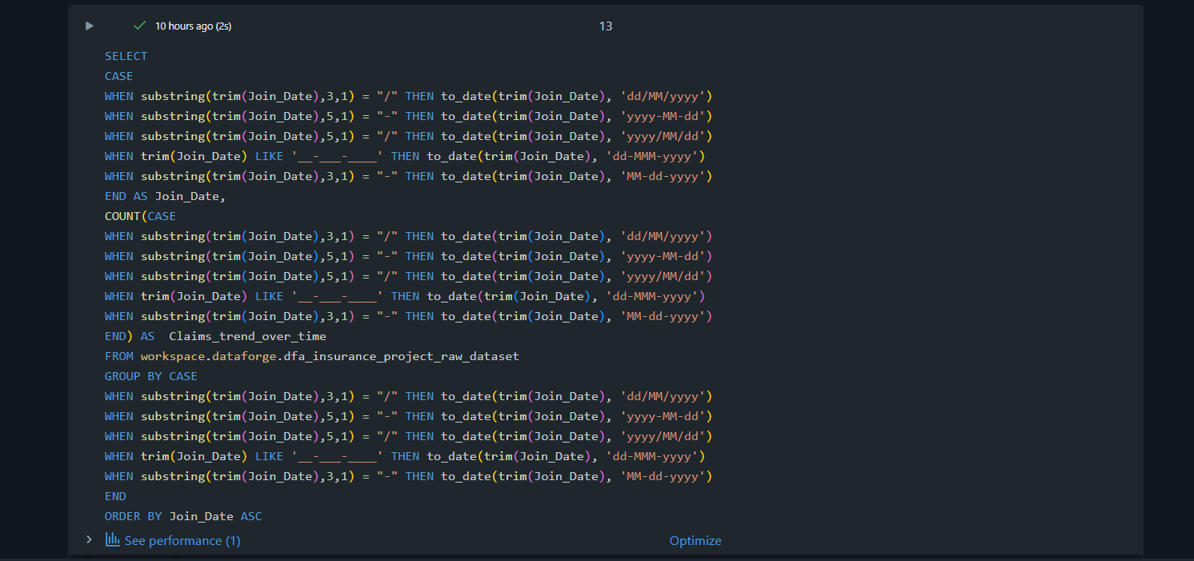
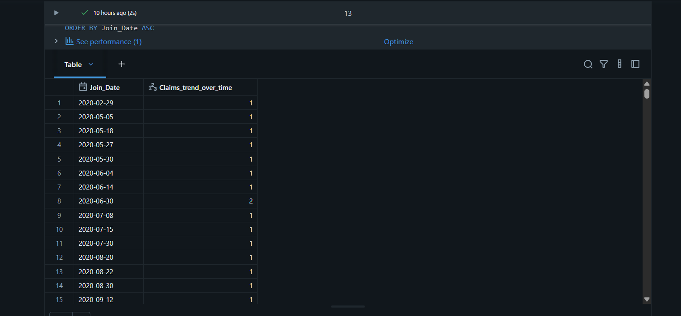
Claims trend over time
Claim over time has mainly single claims with a few multiple claims on some dates.
Considering that there are dates with multiple claims, we could say that the claims are increasing on an upward trend overtime.

Slide 16
Data Cleaning
The dataset was initially very messy, presenting issue such as:
Missing values
Blank values
Text casing inconsistencies
Unnecessary spaces
Inconsistent date formatting
Inconsistent numeric formatting
Inconsistent data types
Redundant naming such as different terms with same meaning

Slide 17
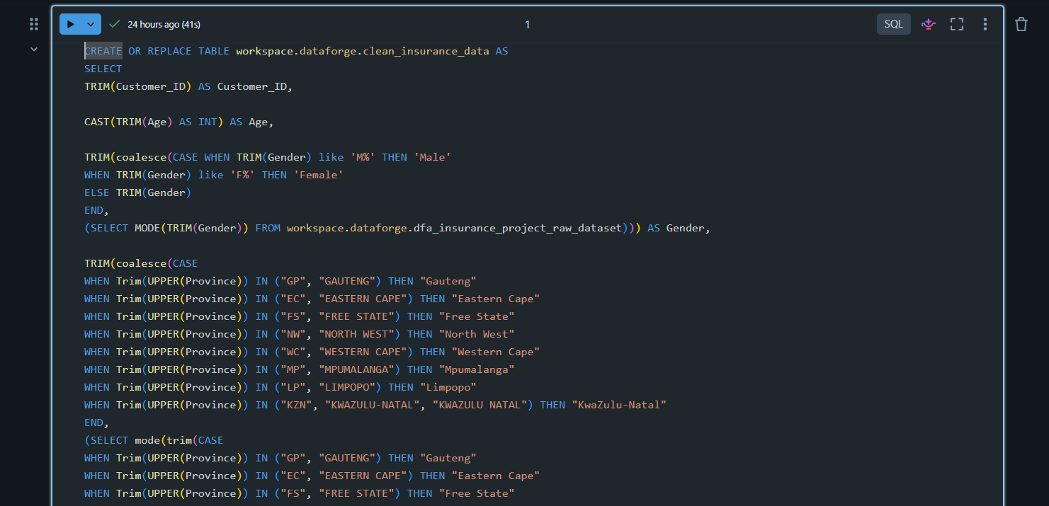
SQL Data Cleaning
The dataset that was ingested on Databricks is cleaned in a separate SQL notebook and it creates a new cleaned dataset.
Customer_ID cleaning:
Removed unnecessary spaces
Gender cleaning:
Removed unnecessary spaces
Replaced missing values
Standardized the values
Age cleaning:
Removed unnecessary spaces
Changed data type to INT

Slide 18
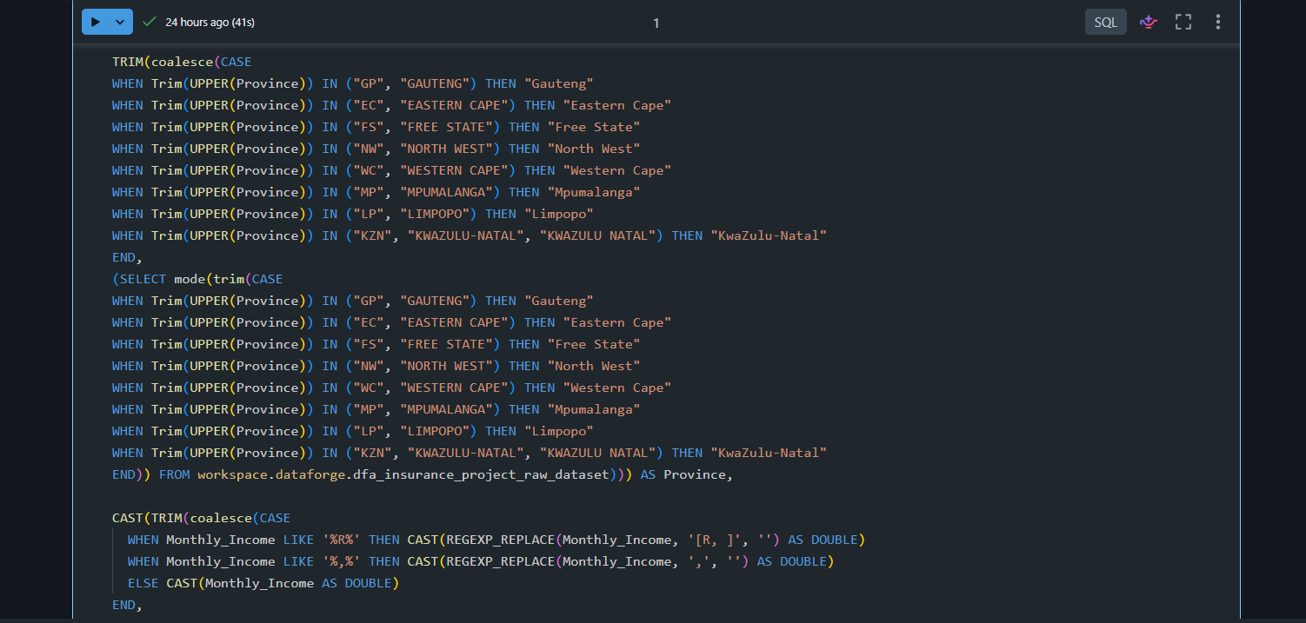
SQL Data Cleaning
Province cleaning:
Removed unnecessary spaces
Replaced missing values
Standardize the missing values

Slide 19
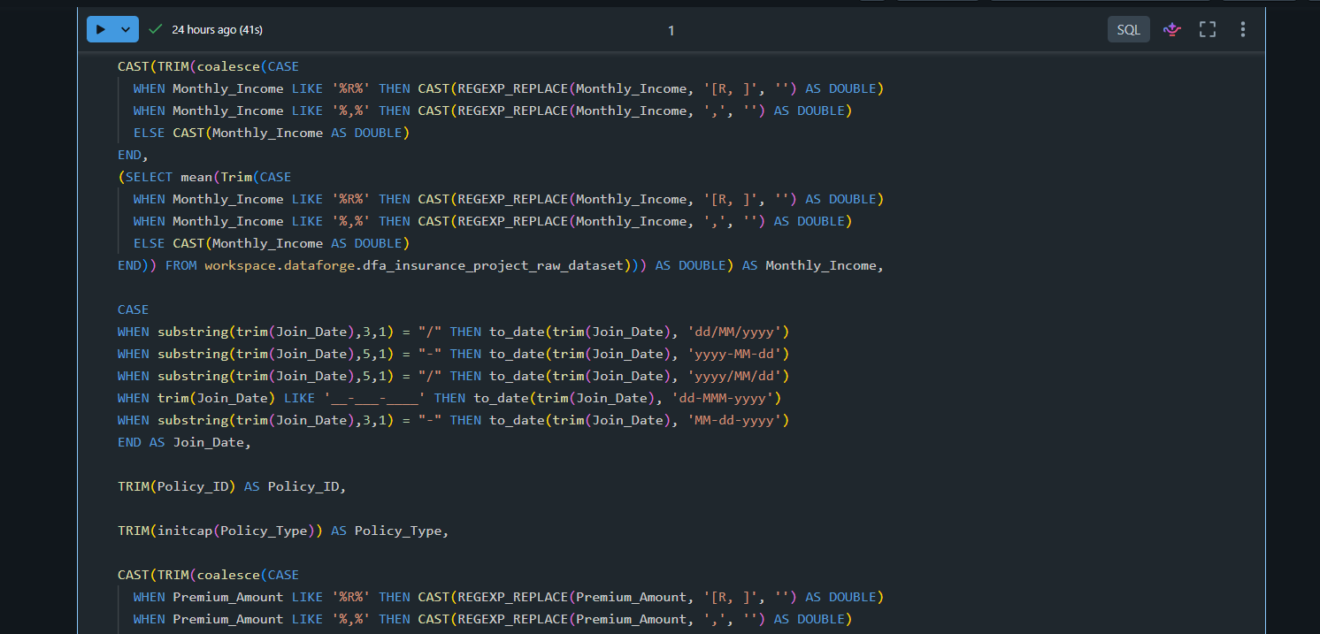
SQL Data Cleaning
Monthly_Income cleaning:
Removed unnecessary spaces
Replaced missing values
Standardized the values
Change data type to DOUBLE
Join_Date cleaning:
Removed unnecessary spaces
Standardized the values
Changed data type to Date
Policy_ID cleaning:
Removed unnecessary spaces

Slide 20
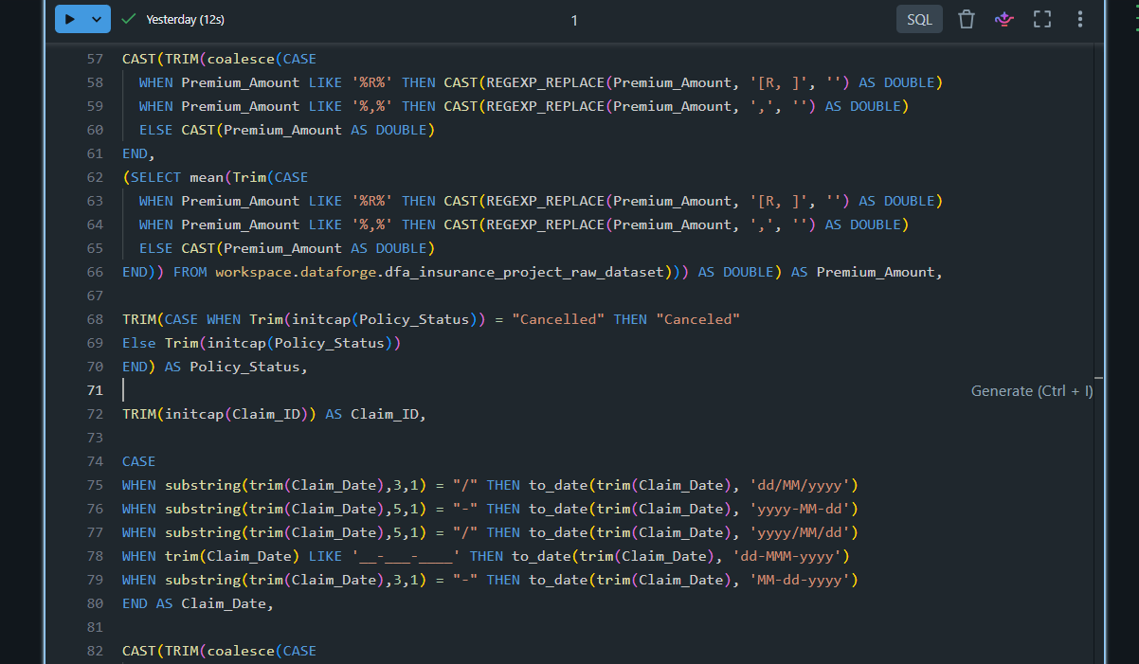
SQL Data Cleaning
Premium_Amount cleaning:
Removed unnecessary spaces
Replaced missing values
Standardized the values
Changed data type to DOUBLE
Policy_Status cleaning:
Removed unnecessary spaces
Standardized the values
Claim_ID cleaning:
Removed unnecessary spaces
Claim_Date cleaning:
Removed unnecessary spaces
Standardized the values
Changed data type to Date

Slide 21
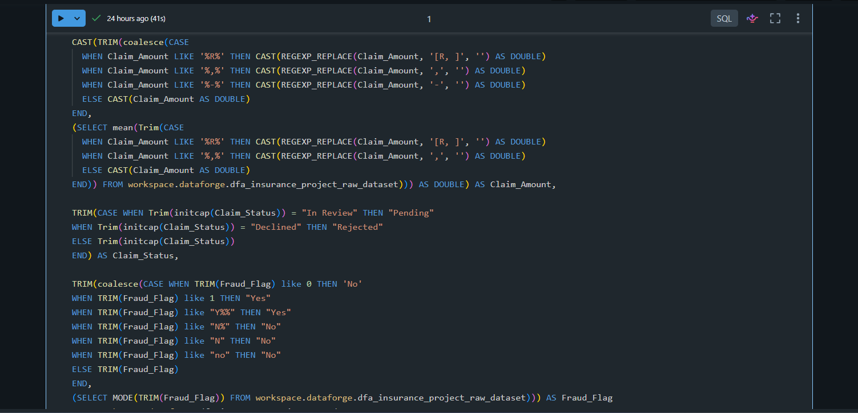
SQL Data Cleaning
Claim_Amount cleaning:
Removed unnecessary spaces
Replaced missing values
Standardized the values
Changed data type to DOUBLE
Claim_Status cleaning:
Removed unnecessary spaces
Standardized the values
Fraud_Flag cleaning:
Removed unnecessary spaces
Standardized the values
Replaced missing values

Slide 22
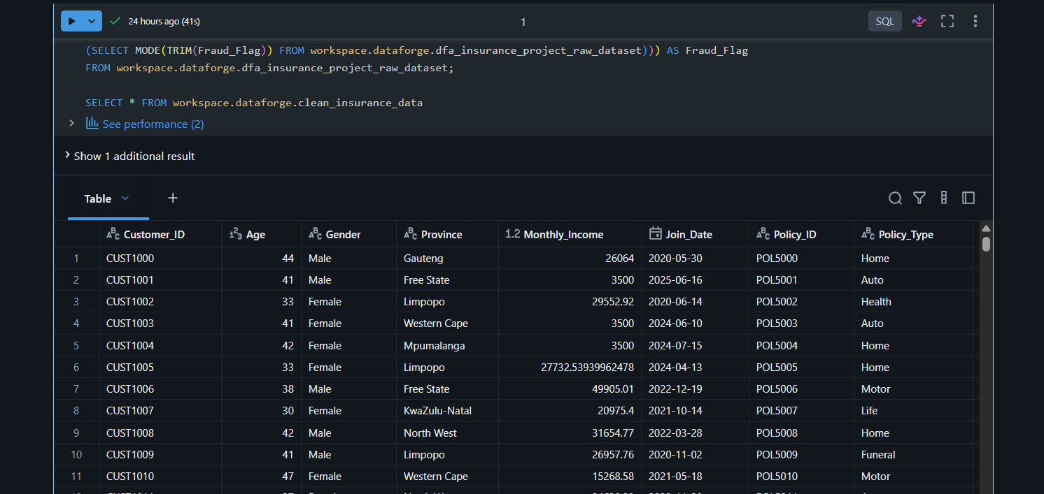
SQL Data Cleaning
The cleaned table is created and displayed with it’s appropriate data types.

Slide 23
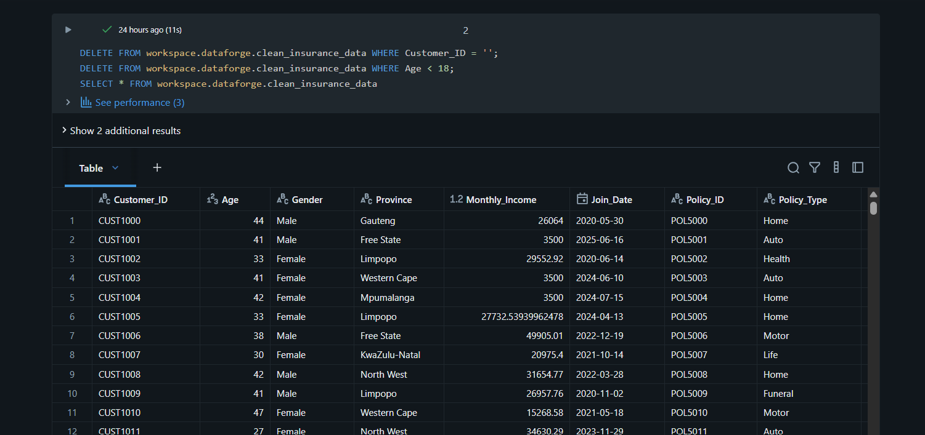
SQL Data Cleaning
Invalid data handling:
Remove data where the Customer_ID is blank
Remove data where the Age of the Customer is under 18

Slide 24
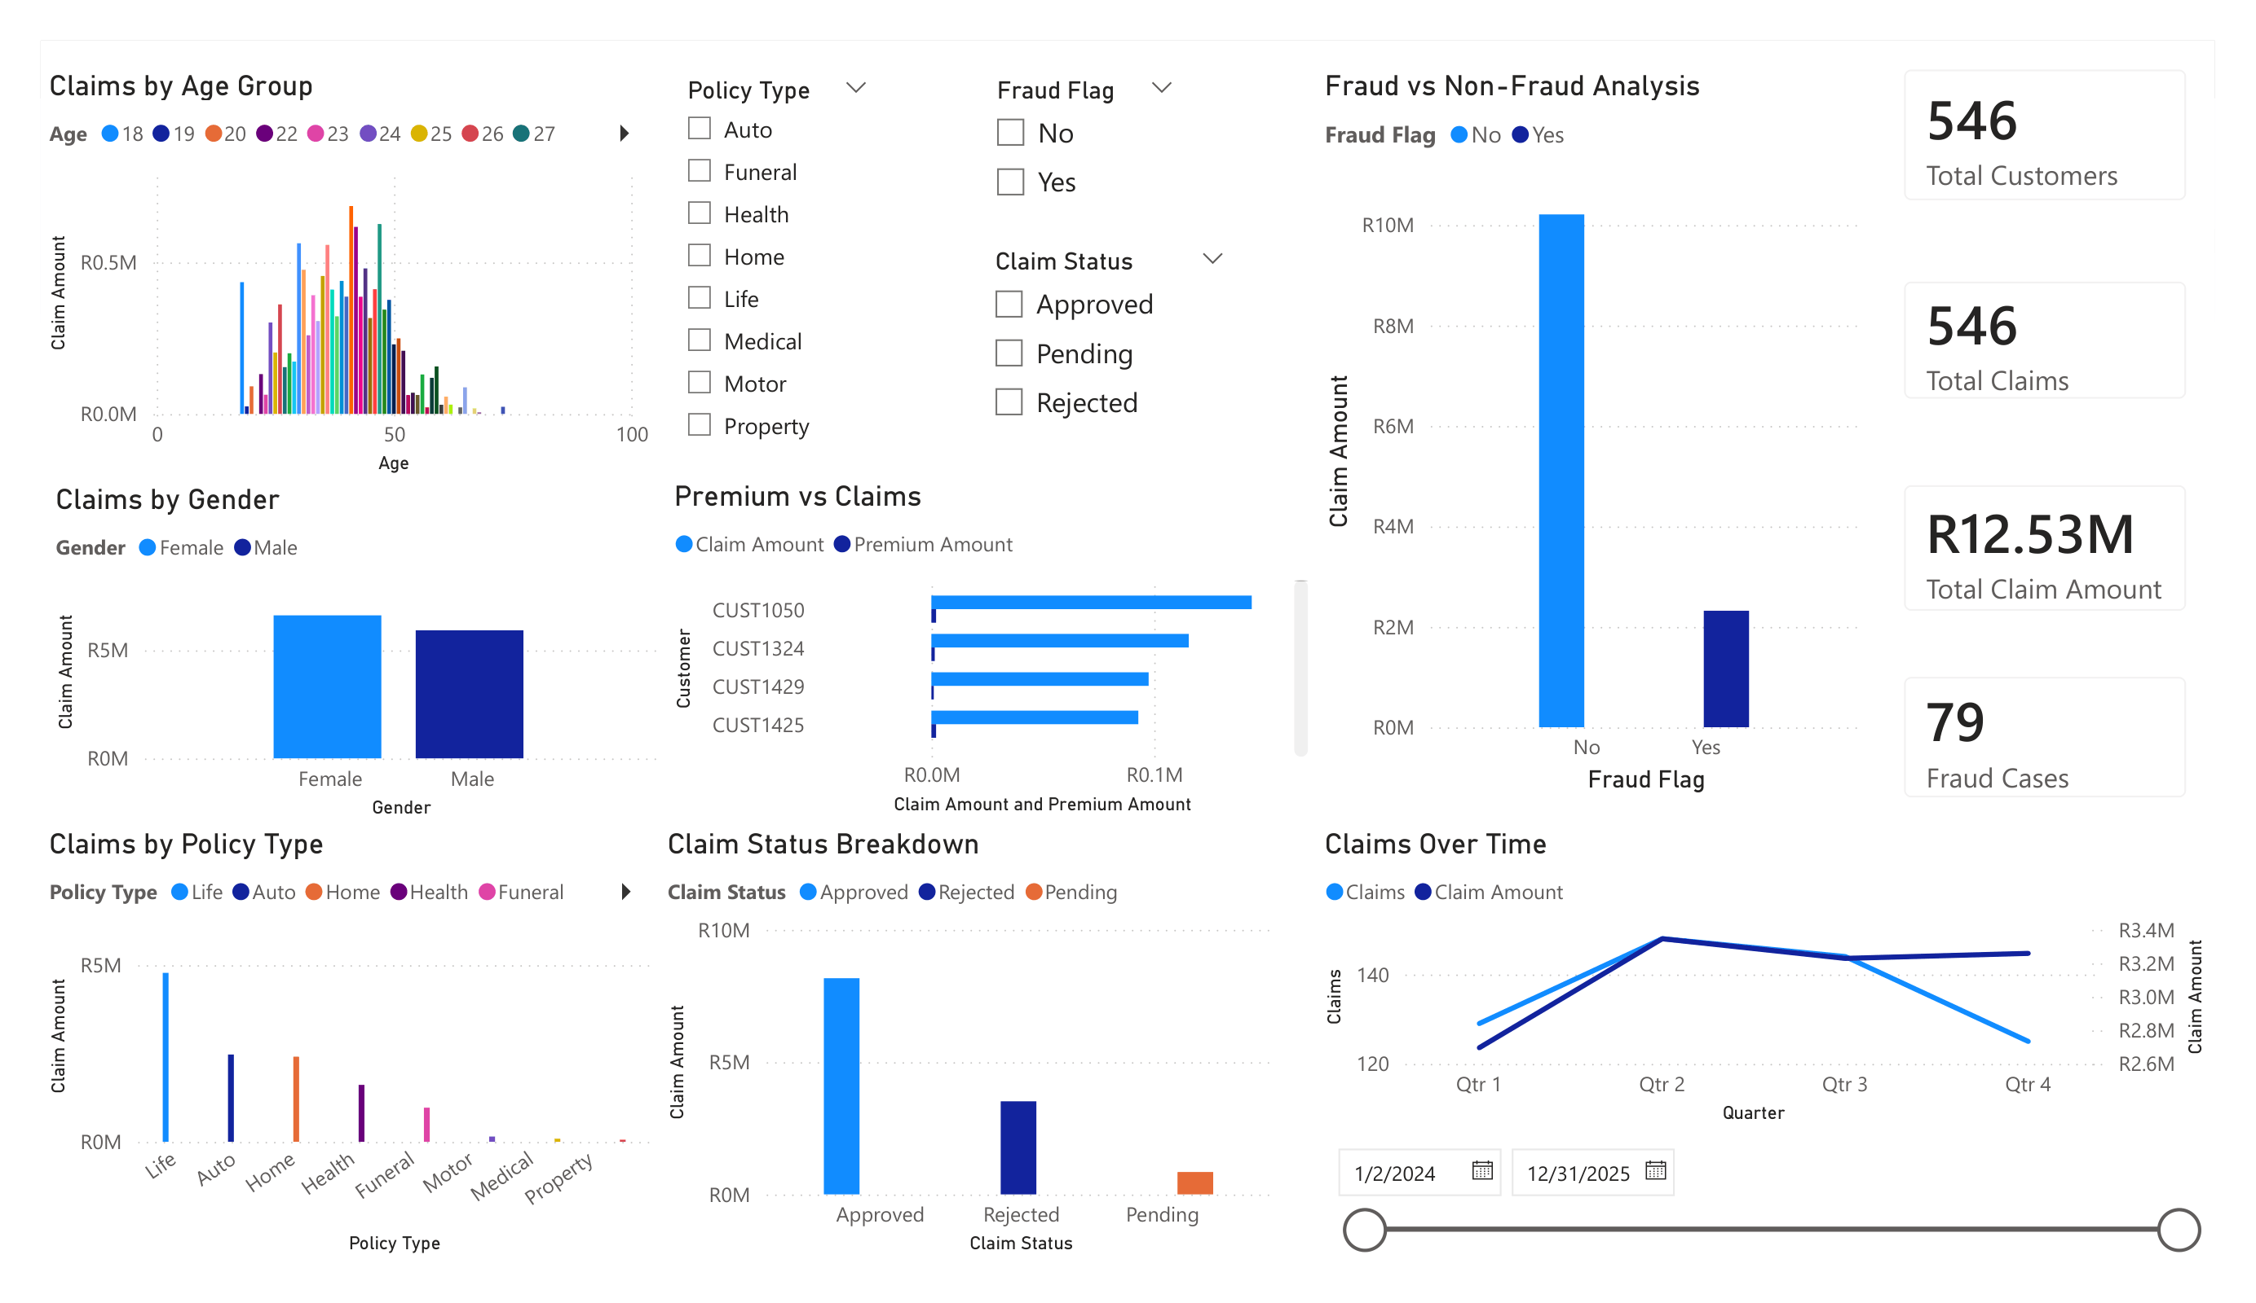
Dashboard and Insights
A Power BI Dashboard was built to visualize and summarize the insights from the cleaned table dataset
Dashboard Link: https://app.powerbi.com/view?r=eyJrIjoiYTAyNTg0MDYtNDJhZi00ZmY0LTk2N2MtMDlhNWZiMGUxMjNiIiwidCI6IjczNjVmODNhLWViY2UtNGM5ZS1iYTI2LWY5ZjM5ZmZhYTk4ZSJ9
Insights were drawn mainly from these questions:
- What trends do you observe?
- Which policy type is most risky?
- Where is fraud most common?
- Which customers or segments are high-risk?

Slide 25
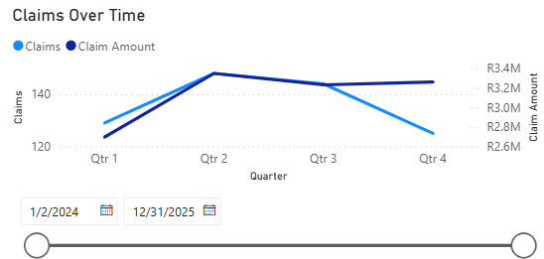
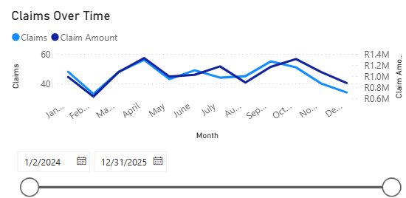
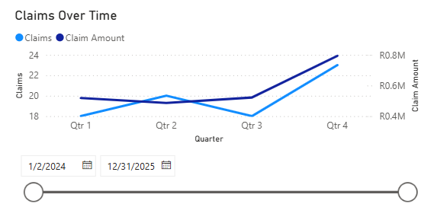
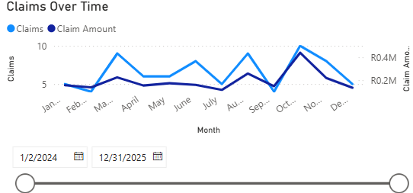
Insights
All Claims
What trends do you observe?
Claims have been on a downward trend in general but the fraudulent claims have been increasing on an upward trend over time along with the claim amount.
Fraudulent Claims

Slide 26
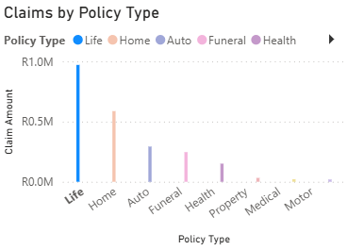
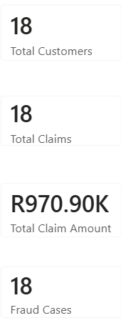
Insights
Which policy type is most risky?
Life policy is most risky as it has 18 claims with that being the highest claim amount of R970,90k in total, 8 of the claims being approved to the amount of R531,48k.

Slide 27
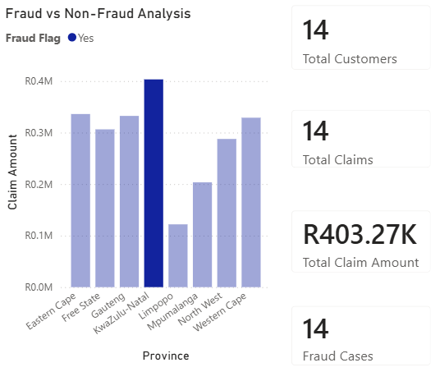
Insights
Where is fraud most common?
Fraud is most common in KwaZulu-Natal as it has 14 fraudulent claims to the amount of R403,27k

Slide 28
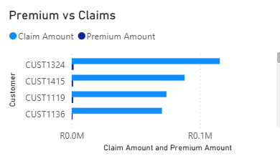
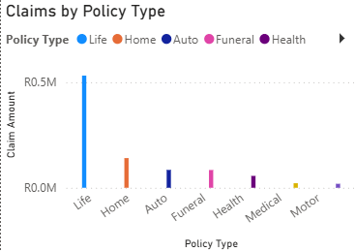
Insights
Which customers or segments are high-risk?
High-Risk Customers
CUST1324 claimed 2 times to the amount of R115,58k
CUST1415 claimed 1 time to the amount of R80,06k
CUST1119 claimed 1 time to the amount of R73,93k
CUST1136 claimed 1 time to the amount of R70,42k
CUST1504 claimed 1 time to the amount of R63,46k
CUST1220 claimed 1 time to the amount of R61,24k
CUST1336 claimed 1 time to the amount of R58,79k
High-Risk Segments
Life policy has 18 claims to the amount of R970,90k
Home policy has 20 claims to the amount of R587,02k
Auto policy has 12 claims to the amount of R292,31k
Funeral policy has 15 claims to the amount of R246,40k
Health policy has 11 claims to the amount of R150,80k

Slide 29
Recommendations
Lower the claim amount of each high-risk segment to discourage customers from doing fraud.
To improve customer retention, it is best to target customers within the age range of 30 years to 50 years and to target males and females earning a monthly income of around R28k.
Make an adjustment to the premiums by increasing them to improve profitability.

Slide 30
THE END
THANK YOU FOR YOUR TIME.
Author
Tlale Prince Lethoko

